Slide 1
Building APIs in Government for Social Good
Tyrone Grandison PhD
Notes:
Background blue = #265994

Slide 2
Deputy Chief Data Officer, US Department of Commerce (2015-16) White House Presidential Innovation Fellow, Department of Labor & US Census Bureau (2014-15)
My Time In Government

Slide 3


Slide 4
The Reality
APIs: Sweat and Toil, CitySDK, MIDAAS
Lessons

Slide 5
government takes on the hardest, inelastic problems
Notes:
While the private sector takes on elastic problems, like entertainment and marketing.
Government takes on hard problems like homelessness, health, safety, defense, trade

Slide 6
optimum
Notes:
The problems are difficult optimization problems not in one dimension.

Slide 7
n-dimensional
Notes:
But rather in multiple dimensions
And many of the dimensions are not anywhere technology or science related.

Slide 8
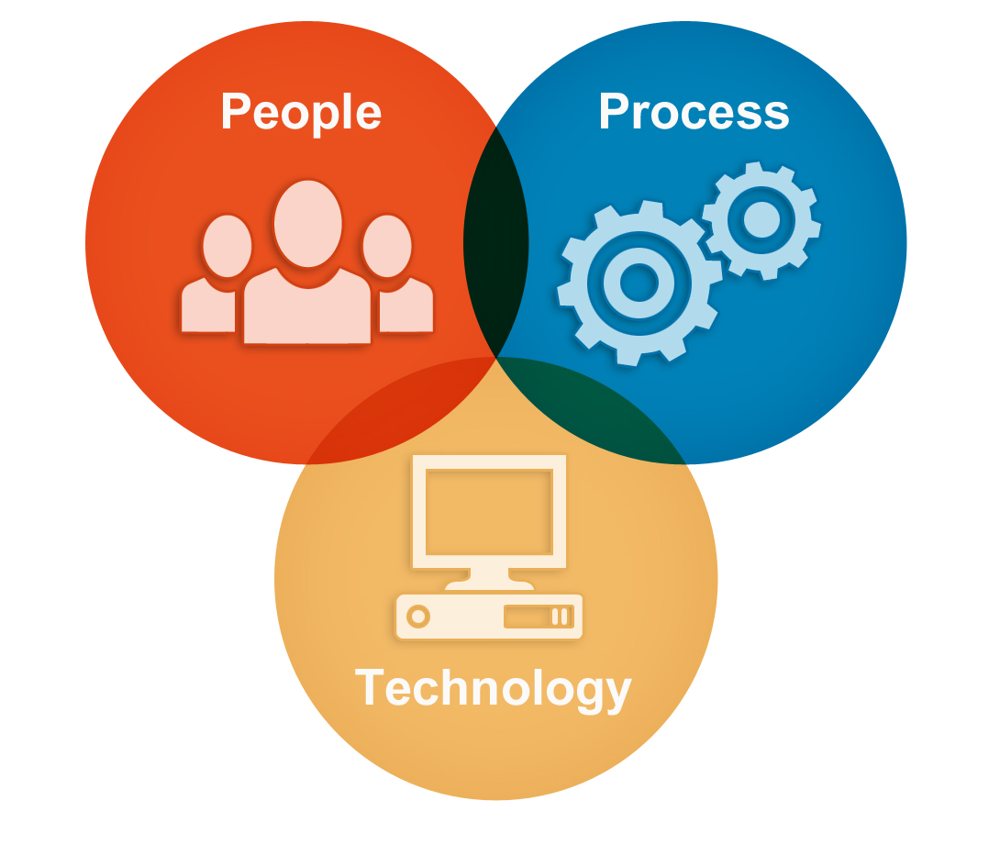

Slide 9


Slide 10
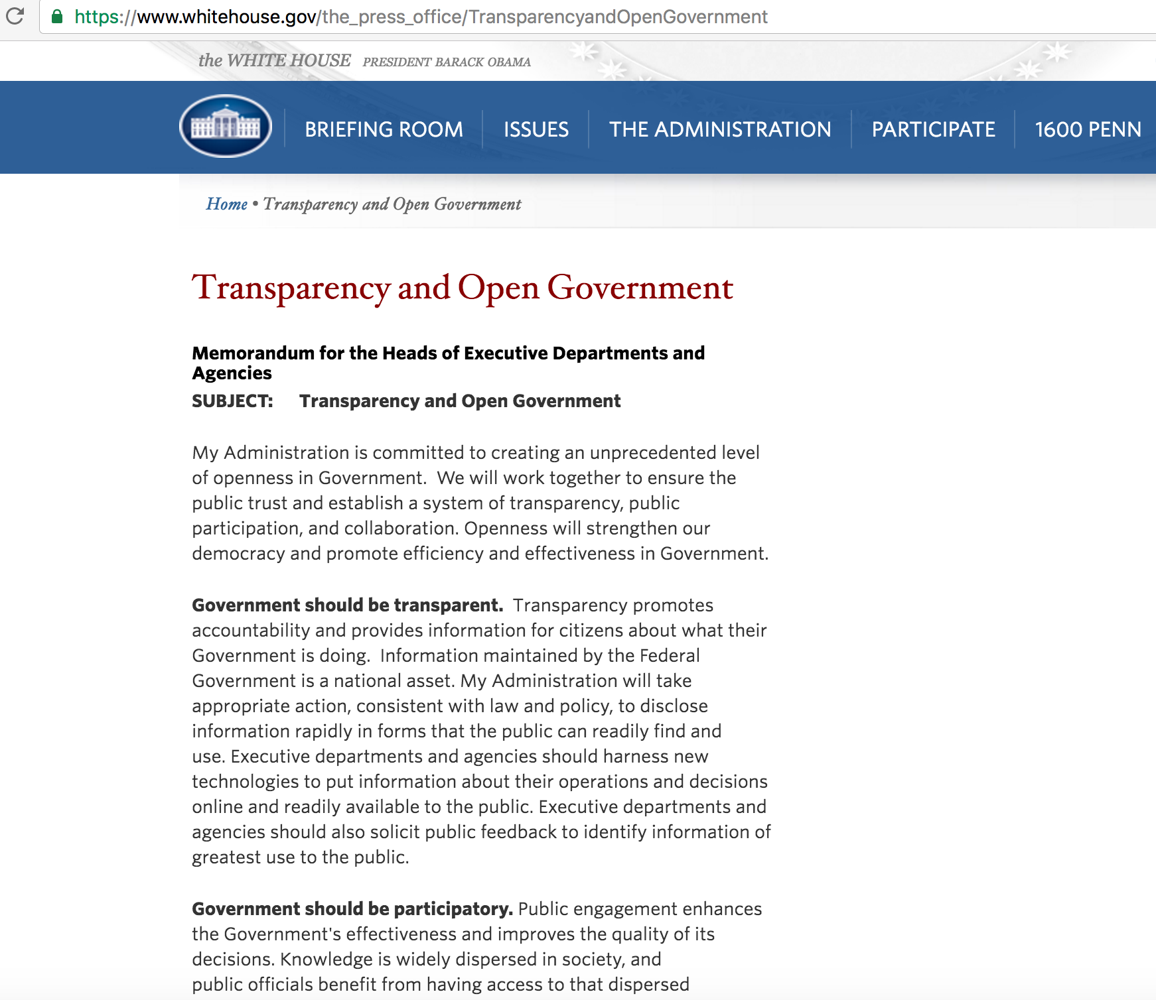
M-13-13

Slide 11
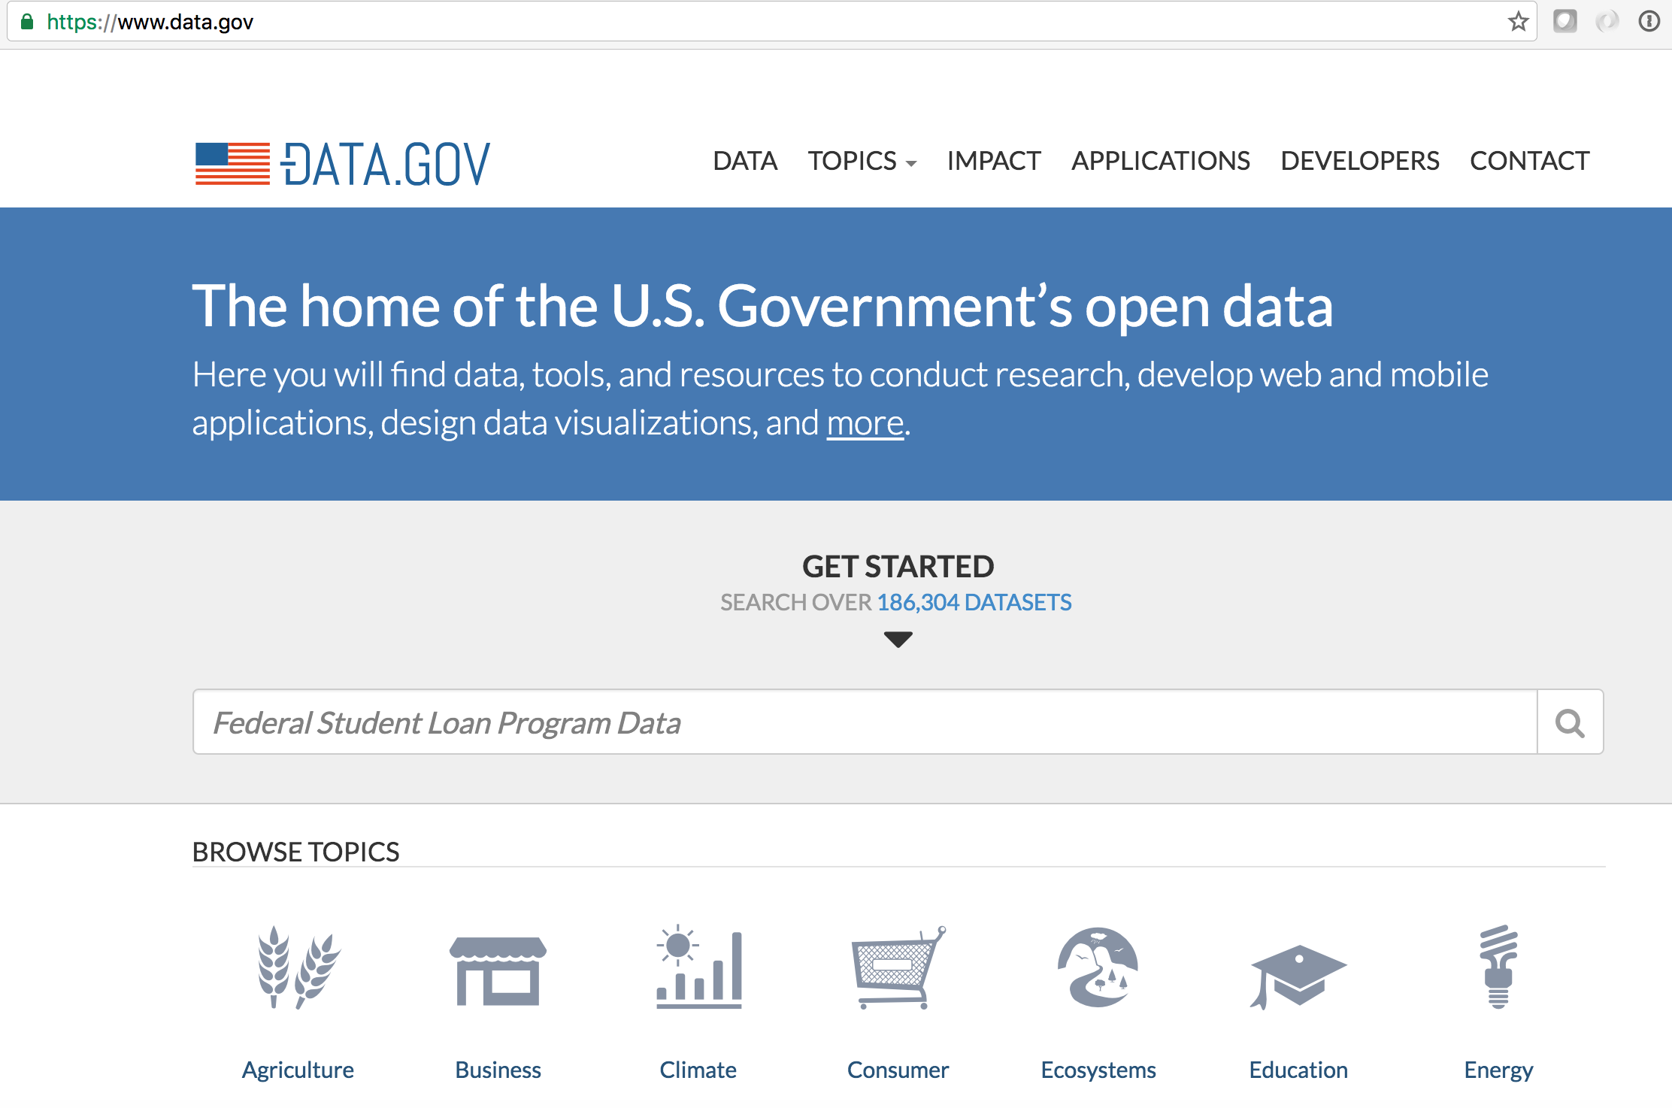

Slide 12
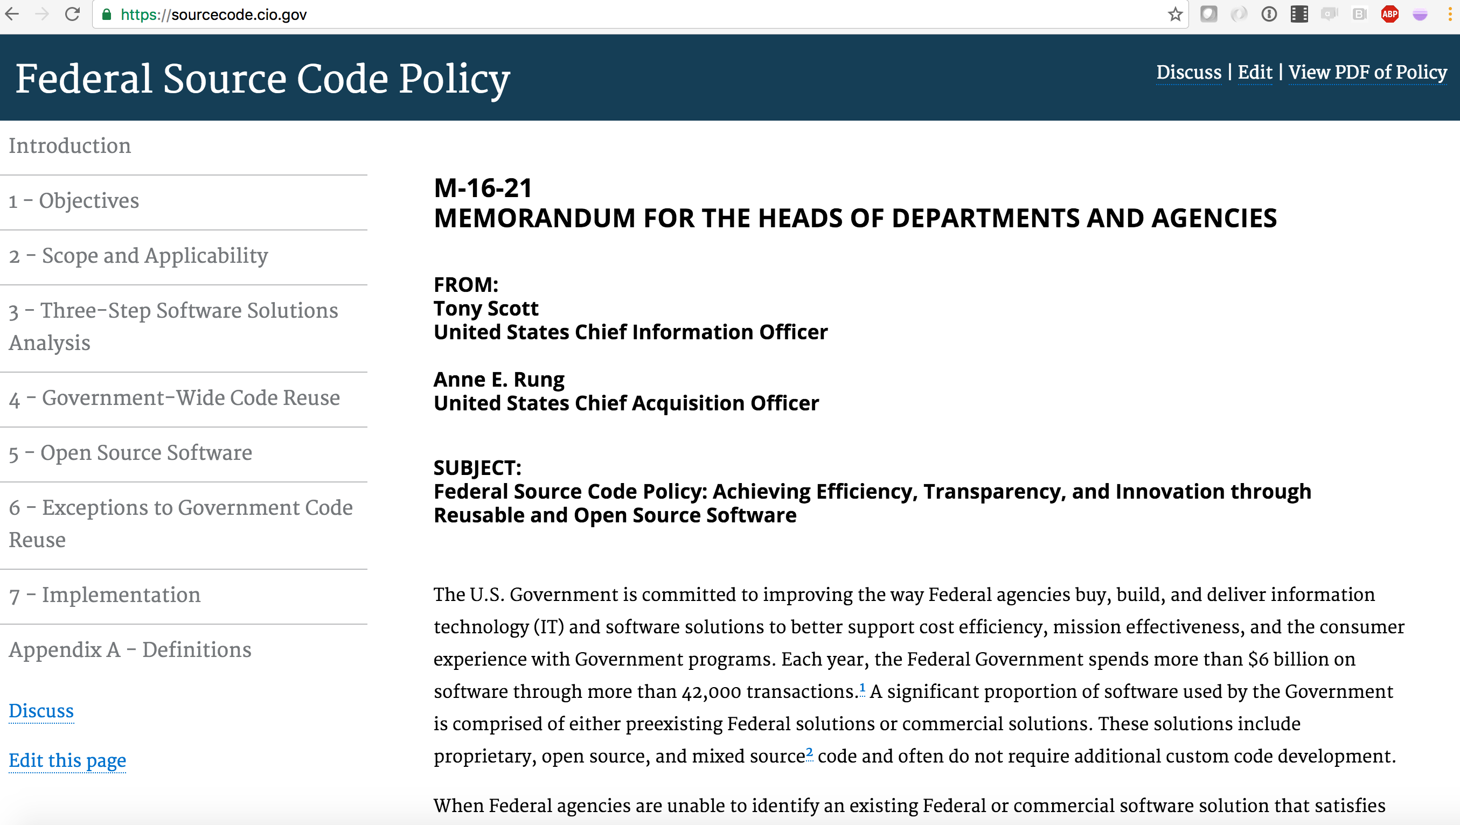

Slide 13

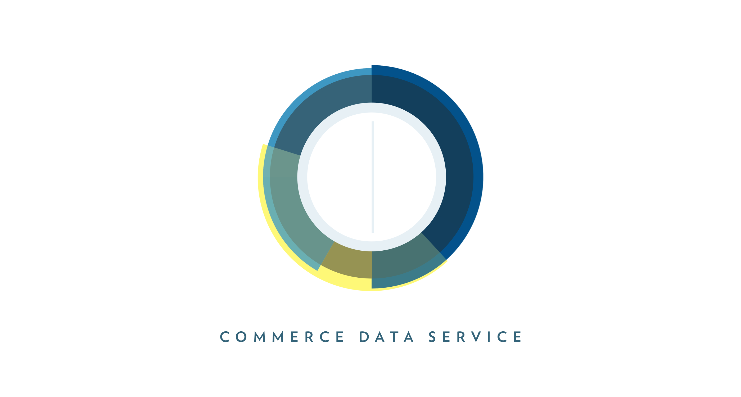


Slide 14
The Reality
APIs: Sweat and Toil, CitySDK, MIDAAS
Lessons

Slide 15
Sweat and Toil http://developer.dol.gov/others/sweat-and-toil

Slide 16

Notes:
Bureau of International Labor Affairs - ILAB publishes three reports on international child labor and forced labor that serve as valuable resources for research, advocacy, government action and corporate responsibility. These reports are The Department of Labor's Findings on the Worst Forms of Child Labor; the List of Goods Produced by Child Labor or Forced Labor; and the List of Products Produced by Forced or Indentured Child Labor. Each of these reports has a distinct mandate, focus and set of implications, but taken collectively, they document the current situation of child labor, forced labor and forced child labor around the world.

Slide 17
Building the API
Coalition and Urgency
Understand The Data Production Process
Find Natural Intervention Point
Learn Technology Constraints
Understand API User
Build
Go to 2

Slide 18
Python
MSSQL
Quarry
Notes:
Quarry – PHP, CodeIgniter,

Slide 19
Census CitySDK https://uscensusbureau.github.io/citysdk/

Slide 20
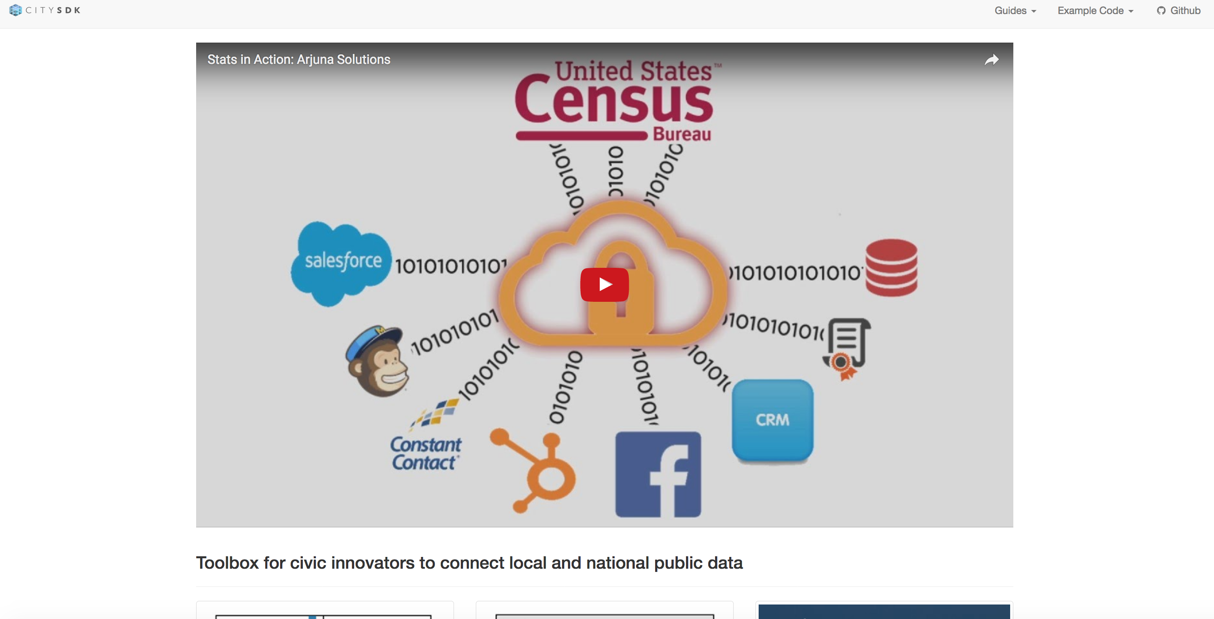

Slide 21
Building the API
Validate The Demand
Understand The User
Create MVP
Go to 2

Slide 22
MVP
JS
beta
node.js

Slide 23
MIDAAS https://midaas.commerce.gov

Slide 24
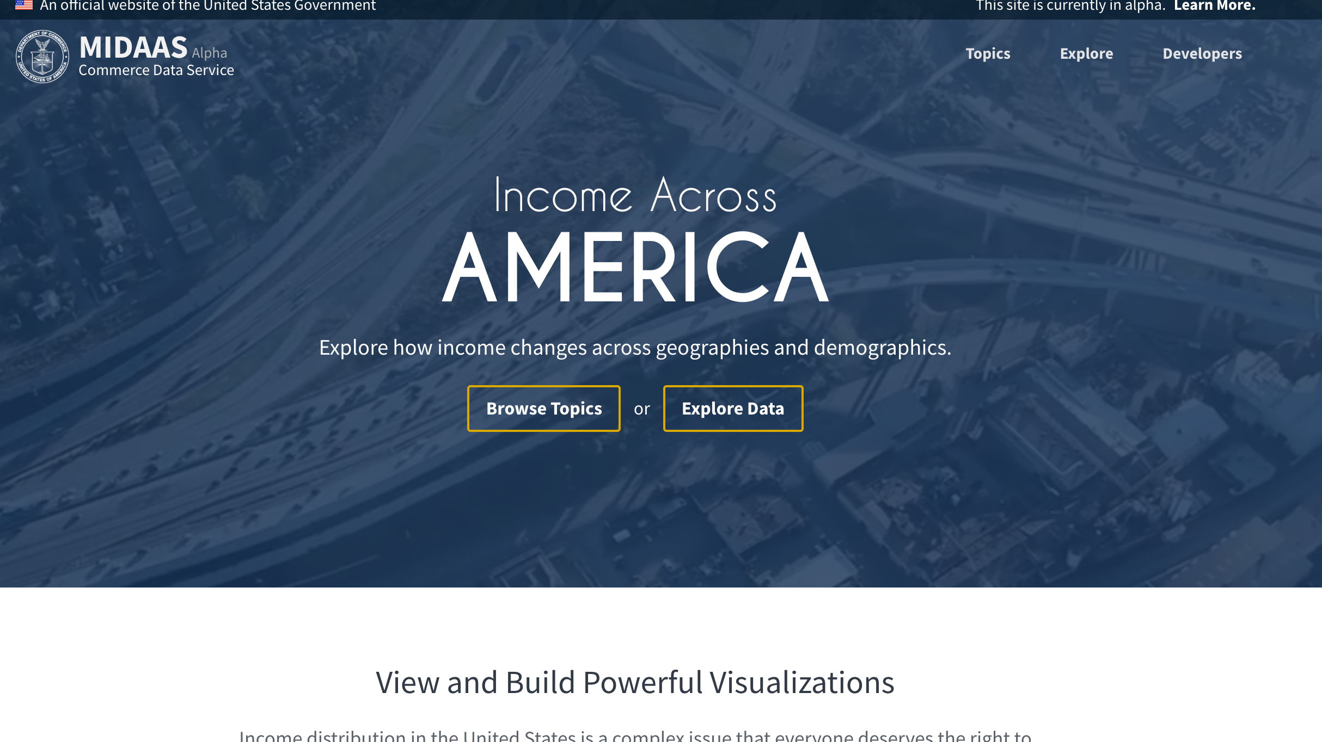

Slide 25
Building the API
Validate Need
Validate with Domain Experts
Understand Initial User Stories
Understand Technical Constraints
Build
Go to 2

Slide 26
Amazon Web Services
MVP
Redshift, Lambda, API Gateway
beta
Postgres, S3, EC2

Slide 27
The Reality
APIs: Sweat and Toil, CitySDK, MIDAAS
Lessons

Slide 28
Summary
People
Scope
Constraints
Validate
Show The Thing

Slide 29
So Far
Sweat and Toil
2016 Department of Labor‘s Innovation Award.
CENSUS CitySDK
2016 Department of Commerce Gold medal
2016 Best Data API Award, API:World
2015 Fedscoop Innovation Of The Year

Slide 30
Thank you
tyronewagrandison@gmail.com

